Slide 1
Operating Systems
SENS-3513
Week: 6
CPU Scheduling
Operating System Concepts
9th edition
Silberschatz, Galvin & Gagne
John Wiley & Sons
2013
Dr Nauman Mazhar
Faculty of Information Technology (FIT)
University of Central Punjab (UCP)

Slide 2
Objectives
CPU Scheduling
Basic Concepts
  CPU & I/O Burst Cycle
  Preemptive & Non-preemptive Scheduling
  Scheduling Objective
Scheduling Criteria
  CPU utilization
  Throughput
  Turnaround time
  Waiting time
  Response time
2

Slide 3
Objectives
Scheduling Algorithms
  First Come First Served (FCFS)
  Shortest Job First (SJF)
  Shortest Remaining Time First (SRTF)
  Priority Scheduling (Pri)
  Round Robin Scheduling (RR)
  Multilevel Queue Scheduling (MQ)
  Multilevel Feedback Queue Scheduling (MFQ)
3

Slide 4
  Scheduling
4

Slide 5


Scheduling
Deciding which process/thread should occupy a resource
(CPU, disk, etc)
(CPU (horsepower))
I want to ride it
Whose turn is it?
Process 1
Process 2
Process 3
5

Slide 6
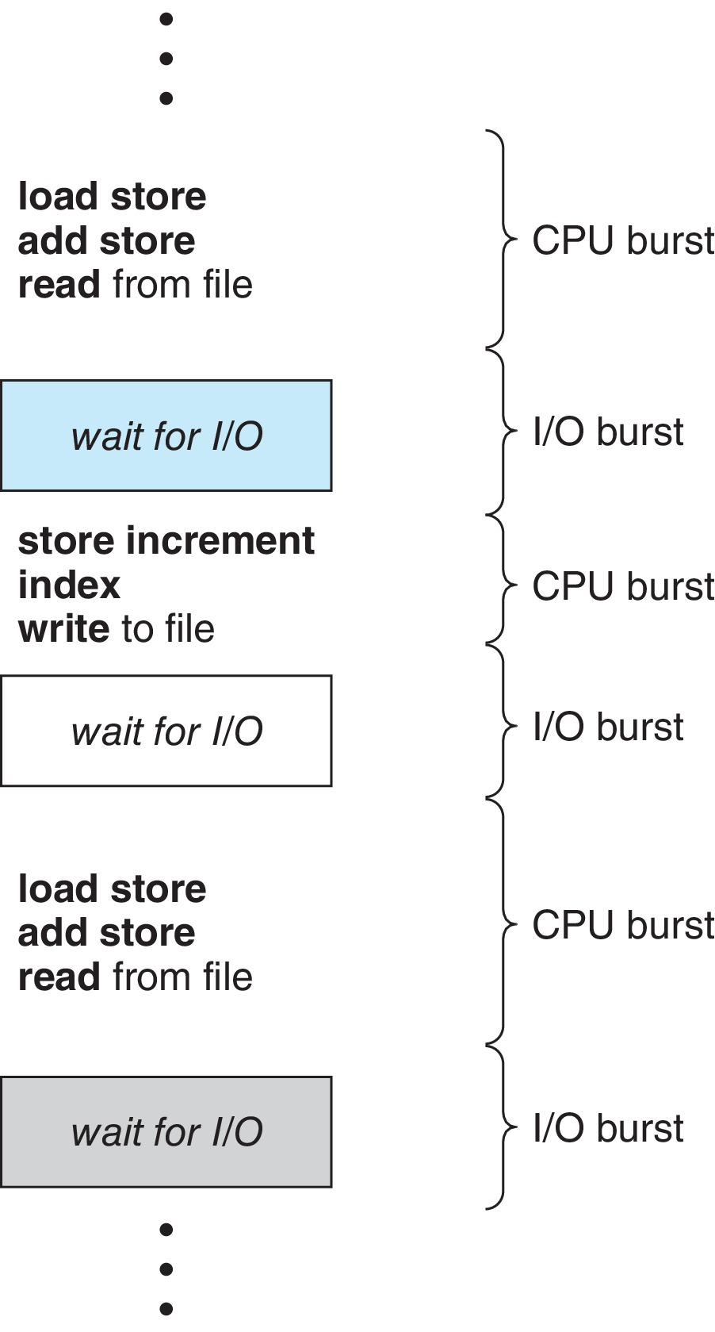
CPU – I/O Burst Cycle
Process execution consists of repeating cycles of…
  CPU execution & I/O wait
  processes move back & forth between these two states
Execution of a process…
  begins with CPU burst
  followed by I/O burst
  & so on
6

Slide 7
CPU Scheduler
Three types of schedulers seen earlier
  Long term scheduler
  Short term scheduler (CPU Scheduler)
  Medium term scheduler (swapper)
CPU Scheduler
  “kernel component that decides,
  which process should run next, how long it should run,
  and when it should be interrupted to allow another process to run”
  goal is to optimize use of CPU, and ensure all processes receive
  fair & efficient access to CPU resources
  when CPU gets idle, scheduler selects a process from Ready Queue to be executed next
7

Slide 8
CPU Scheduler
CPU scheduling decisions may take place when a process…
  switches from running to waiting state
  (for doing I/O)
  switches from running to ready state
  (when time slice of a process expires, or interrupt occurs)
  switches from waiting to ready state
  (on completion of I/O)
  terminates
  a new process arrives
8

Slide 9
Dispatcher
Dispatcher
  OS code that takes CPU away from current process, &
  hands it over to newly scheduled process
  important component involved in CPU scheduling
  gives CPU to process selected by short term scheduler
Performs following functions:
  switch context
  change CPU mode to user
  jump to proper location in user program to restart that program
Dispatch latency – time it takes for dispatcher to stop one process & start executing another
9

Slide 10
Main Categories of Scheduling
Pre-emptive Scheduling
  scheduler decides when one process is stopped, & a new process is run, as per some scheduling policy
  Time Slice: duration a process executes, before pre-emption
  (usually fixed)
  modern OS may compute time slice dynamically
  (as function of process behavior & configurable system policy)
Non-preemptive Scheduling
  running process can only lose processor voluntarily
  (by terminating, or requesting I/O)
  once CPU given to a process, it cannot be pre-empted until process completes its CPU burst
10

Slide 11
Scheduling Objectives
Fairness (nobody cries)
Priority (ladies first)
Efficiency (make best use of equipment)
Encourage good behavior (good boy/girl)
Support heavy loads (degrade gracefully)
11

Slide 12
Scheduling Criteria
CPU utilization
  keep CPU as busy as possible
Throughput
  number of processes that complete
  their execution per time unit
Turnaround time
  amount of time to execute a particular process
  Turn Around Time → T.A.T = F.T – A.T
  W.T to get into memory + W.T in Ready Q +
  Execution time + I/O time
Arrival Time : A.T
Start Time : S.T
Burst Time : B.T
Wait Time : W.T
Finish Time : F.T
12

Slide 13
Scheduling Criteria
Waiting time
  amount of time a process has been waiting in Ready Queue
  for Non-preemptive Algos W.T = S.T – A.T
  for Preemptive Algos W.T = F.T – A.T – B.T
  = T.A.T – B.T
Response time
  amount of time it takes from
    when process arrives in ready queue for the first time,
    until it first gets the CPU & starts executing
  for time-sharing environment
13

Slide 14
Optimization Criteria
Maximize CPU utilization
Maximize throughput
Minimize turnaround time
Minimize waiting time
Minimize response time
14

Slide 15
Classification of Processes
Classification of processes for scheduling algorithms:
CPU bound process
  process spends more time doing computation, & tries to hold CPU for longer durations
  (image processing applications, network traffic simulators)
I/O bound process
  processes spend more time doing I/O, & tries to hold I/O devices for longer durations
  (text editors, printing application like billing system)
Classifications not mutually exclusive – process can exhibit both behaviors
  word processor (I/O bound) can become CPU bound
  when doing spell check or macro calculations
15

Slide 16
  Scheduling Algorithms
16

Slide 17

First Come First Serve
FCFS – Process that arrives First, gets CPU First
  Non-preemptive
  used in batch systems
  no real time user interaction
Implemented as FIFO Queue
  when process enters RQ → PCB linked to tail of Queue
  when CPU free → scheduler selects from head of Queue
  when process blocked → goes to Queue tail
Performance metric – Average Waiting Time (AWT)
Given parameters:
  Arrival Time, Order, Burst Time (in ms)
17

Slide 18
First Come First Serve
Simplest CPU scheduling algorithm
  can be generalized to processes with alternate CPU & I/O bursts
Limitations
  FCFS favors long processes, compared to short ones
  (Convoy effect)
  tends to favor CPU bound, over I/O bound processes
  average wait time is often quite long
  non-preemptive – troublesome for time sharing systems
18

Slide 19
Convoy Effect
“Convoy effect occurs when a set of processes
need to use a resource for a short time,
& one process holds resource for a long time, blocking all others,
causing poor utilization of system resources”
Consider n-1 I/O bound jobs, & 1 CPU bound job…
  I/O bound jobs pass thru RQ quickly, and block waiting for I/O
  CPU bound job arrives at head of Queue, & executes
  I/O bound jobs rejoin RQ, but need to wait for CPU bound job
  I/O devices idle, until CPU bound job completes
  when CPU bound job completes, other processes rush to wait on I/O again
  CPU becomes idle
19

Slide 20
FCFS – Example 1
Process | Duration / B.T | Order | Arrival Time
P1 | 24 | 1 | 0
P2 | 3 | 2 | 3
P3 | 4 | 3 | 4
Final schedule:
P1 (24)
P2 (3)
P3 (4)
0
24
27
P1 waiting time: 0-0 = 0
P2 waiting time: 24-3 = 21
P3 waiting time: 27-4 = 23
The average waiting time:
(0+21+23)/3 = 14.667
20

Slide 21
FCFS – Example 2
Draw graph (Gantt chart) & compute Average Waiting Time for following processes using FCFS scheduling algorithm.
Process Arrival time Burst Time
P1 1 16
P2 5 3
P3 6 4
P4 9 2
21

Slide 22
SJF & SRTF Scheduling
CPU assigned to process with smallest next CPU burst
  if same length next CPU bursts, FCFS scheduling
Shortest Job First (SJF)
  non-preemptive algorithm
  if new arriving process has shorter next CPU burst than what is left of currently executing process
    allow current process to finish its CPU burst
Shortest Remaining Time First (SRTF)
  preemptive algorithm
  if new arriving process has shorter next CPU burst than what is left of currently executing process
    preempt currently running process
22

Slide 23
SJF – Example 3
Process | Duration / B.T | Order | Arrival Time
P1 | 6 | 1 | 0
P2 | 8 | 2 | 0
P3 | 7 | 3 | 0
P4 | 3 | 4 | 0
P4 (3)
P1 (6)
P3 (7)
P2 (8)
0
3
9
16
24
P4 waiting time: 0-0
P1 waiting time: 3-0
P3 waiting time: 9-0
P2 waiting time: 16-0
Total running time is: 24
Average waiting time (AWT):
(0+3+9+16)/4 = 7 time units
23

Slide 24
SRTF – Example 4
Process | Duration | Order | Arrival Time
P1 | 10 | 1 | 0
P2 | 2 | 2 | 2
P1 (2)
P2 (2)
P1 (8)
0
2
4
12
P1 waiting time: 4-2 =2
P2 waiting time: 0
The average waiting time (AWT):
(0+2)/2 = 1
Now run this using SJF!
24

Slide 25
SJF & SRTF – Example 5
Draw graph (Gantt chart) & compute Wait time & Turn Around time for processes using SJF & SRTF.
Process Arrival Time Burst Time
P1 0 8
P2 1 4
P3 2 9
P4 3 5
25

Slide 26
SJF & SRTF – Example 6
Draw the graph (Gantt chart) and compute wait time and turn around time for following processes, using SJF & SRTF.
Process Arrival Time Burst Time
P1 0 5
P2 1 2
P3 2 3
P4 3 1
26

Slide 27
SJF & SRTF – Example 7
Draw the graph (Gantt chart), and compute wait time & turn around time for following processes, using SJF & SRTF.
Process Arrival Time Burst Time
P1 0 9
P2 3 6
P3 6 2
P4 9 1
27

Slide 28
Priority Scheduling
Priority number (integer) associated with each process
CPU allocated to process with highest priority
(smallest integer ≡ highest priority)
Priority scheduling can be preemptive or non-preemptive…
  Preemptive – preempts CPU, if priority of new process higher
  than current process
  (SRTF priority is predicted next CPU burst time)
  Non preemptive – puts new process at tail of RQ
Problem → Starvation / Indefinite Blocking
(low priority processes may be delayed or never executed)
Solution → Aging
(gradually increase priority of processes that wait for long time)
28

Slide 29
Priority Scheduling – Example 8
Lower priority # == More important
Process | Duration | Priority # | Arrival Time
P1 | 6 | 4 | 0
P2 | 8 | 1 | 0
P3 | 7 | 3 | 0
P4 | 3 | 2 | 0
P2 (8)
P4 (3)
P3 (7)
P1 (6)
0
8
11
18
24
P2 waiting time: 0
P4 waiting time: 8
P3 waiting time: 11
P1 waiting time: 18
Average waiting time (AWT):
(0+8+11+18)/4 = 9.25
(worse than SJF’s)
29

Slide 30
Priority Scheduling – Example 9
Draw the graph (Gantt chart), and compute wait time & turn around time for following processes, using Priority scheduling
Process Priority Arrival Time Burst Time
P1 10 0 5
P2 20 1 4
P3 30 2 2
P4 40 4 1
30

Slide 31
Round Robin (RR) Scheduling
RR is Preemptive algorithm
  designed especially for time sharing systems
Clock interrupt generated at periodic intervals
  Time Quantum or Time Slice
Implementation by CPU scheduler…
  maintain RQ as FIFO queue
  add new process to tail
  to select a process, pick the one at head of queue
  set timer to interrupt after 1 time quantum
  dispatch the process
31

Slide 32
Round Robin (RR) Scheduling
As process runs, one of two things will happen:
Current running process has CPU burst < 1 time quantum
  process itself releases CPU voluntarily
  scheduler then proceeds to next process in RQ
Current running process has CPU burst ≥ 1 time quantum
  timer goes off
  causes interrupt to OS
  context switch executed
  process put at tail of RQ
  CPU scheduler then selects next process from RQ
32

Slide 33
RR Performance
Performance of RR depends heavily on length of time quantum
  if time quantum very large
    larger than largest CPU burst of any process
    RR policy become FCFS policy
  if time quantum very short
    RR approach called processor sharing
    short processes move through system relatively quickly
Limitation
  CPU bound processes tend to receive unfair portion of time
  poor performance of I/O bound processes
33

Slide 34
RR Performance
Effect of Context Switch on Performance
Assume, a process of 10 time units…
Quantum – 12 time units
  process finishes in less than 1 time quantum; no overhead
Quantum – 6 time units
  process requires 2 quanta; involves context switch
Quantum – 1 time unit
  9 context switches occur; slow execution of process
“Time quantum should be large w.r.t context switch time”
  if context switch time is approx 5% of time quantum
  about 5% of CPU time is spent in context switching
34

Slide 35
RR – Example 10
Draw the graph (Gantt chart) and compute turn around time for the following processes using RR Scheduling algorithm. Consider a time slice of 4 sec. Also find response time.
  Process Arrival Time Burst Time
  P1 0 16
  P2 1 3
  P3 2 3
35

Slide 36
RR – Example 11
Draw the graph (Gantt chart) and compute turn around time for following processes using RR Scheduling algo. Consider a time slice of 3 sec. Also find response time.
Process Arrival Time Burst Time
P1 0 8
P2 2 4
P3 3 2
P4 6 5
NOTE: Priority of placing process in Ready Queue
    New Process
    Running Process
36

Slide 37
RR with I/O – Example 12
Draw the graph (Gantt chart) & compute turn around time for processes using RR. Consider time slice of 3 sec. Every even number process performs I/O after every 2 sec of its running life. I/O takes 10 seconds.
Process Arrival Time Burst Time
P1 0 8
P2 2 3
P3 3 5
P4 6 4
NOTE: Priority of placing a process in Ready Queue
    New Process
    Blocked Process or I/O process
    Running Process
37

Slide 38
RR with I/O – Example 13
Draw the graph (Gantt chart) & compute turn around time for processes using RR. Consider time slice of 3 sec. Every odd number process perform I/O after every 2 sec of its running life. I/O takes 10 seconds.
Process Arrival Time Burst Time
P1 0 6
P2 2 3
P3 3 5
P4 6 4
38

Slide 39
RR with I/O – Example 14
Schedule processes using RR
  Process P1, P2 & P3 arrive at time units 0, 1 & 2 respectively
  P1 demands CPU for 3 time quantum, then goes for I/O for 6 time quantum
  again demands CPU for 2 quantum, and goes for I/O for 4 quantum
  finally demands CPU for 4 CPU quantum, before it terminates
  Assume RR time slice of 4 time units
Processes | CPU Burst | I/O Burst | CPU Burst | I/O Burst | CPU Burst
P1 | 3 | 6 | 2 | 4 | 4
P2 | 5 | 4 | 3
P3 | 6 | 8 | 5 | 7 | 2
39

Slide 40
Multilevel Queue Scheduling
Multilevel Queue scheduling partitions RQ into separate queues:
  Foreground (interactive)
  Background (batch)
On arrival, process permanently assigned to one queue
(based on some property of process;
process priority, process type, memory size used)
  process does not move between queues
Each queue has its own scheduling algo
  Foreground – RR
  Background – FCFS
  scheduling must be there between queues
(foreground queue may have priority over background one)
40

Slide 41
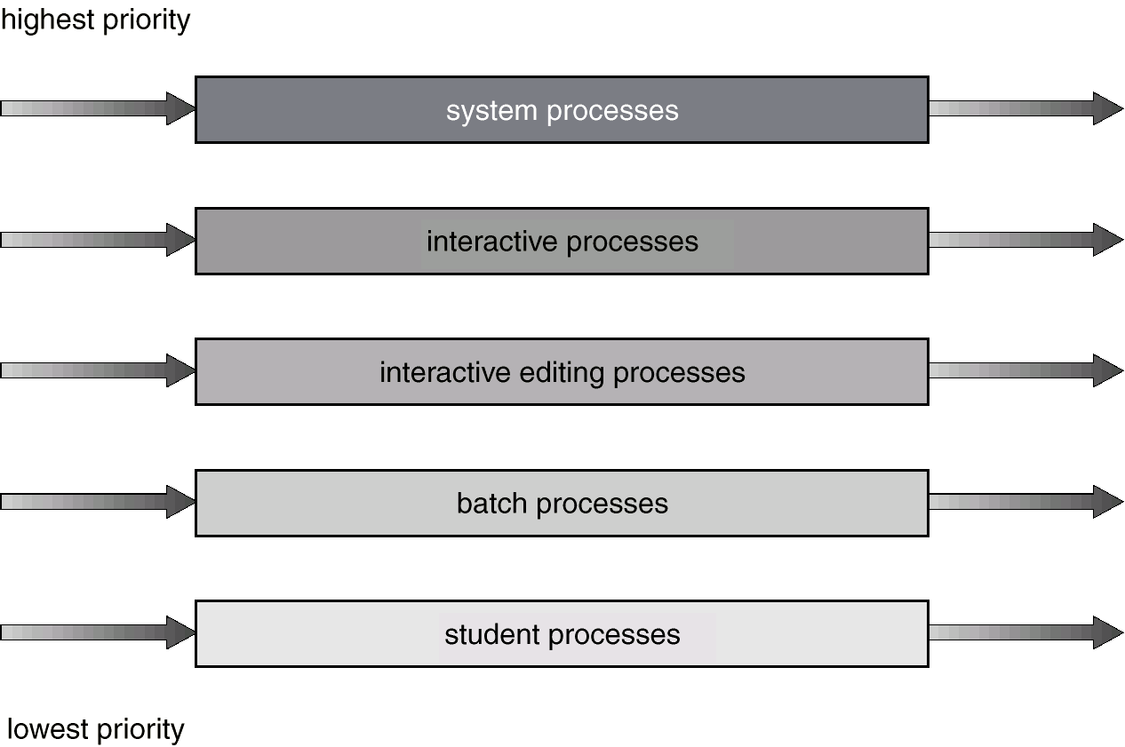
Multilevel Queue Scheduling
41

Slide 42
What is Multilevel Queue Scheduling in OS?
The Multilevel Queue Scheduling algorithm is implemented when processes in a ready queue are divided into different classes with different scheduling needs. For example, we can consider a system with foreground and background processes. Here we can have two classes; one of the foreground processes and the other class of background processes; each having a separate set of scheduling needs. This situation is one where Multilevel Queue Scheduling can be implemented.

Slide 43
Multilevel Feedback Queue Scheduling
Multilevel feed back queue scheduling allows a process to:
“move between various queues”
Process using too much CPU time is moved to lower priority queue with larger time quantum
  leaves interactive & I/O bound processes in higher priority queue with small time quantum
Aging is done to prevent Starvation
  process that waits too long in low priority queue is moved up to
  higher priority one
43

Slide 44
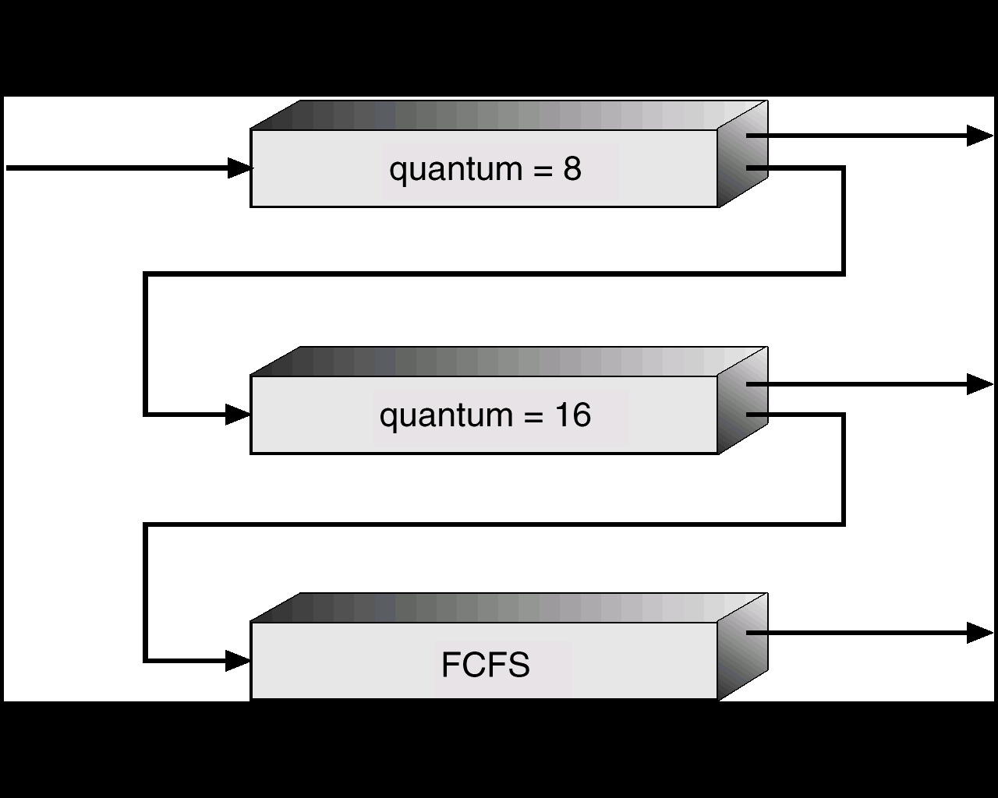
Multilevel Feedback Queues
44

Slide 45
Multilevel Feedback Queue Scheduling
Parameters of Multilevel feedback queue scheduler:
  number of queues
  scheduling algo for each queue
  method to determine which queue process will enter
  when process needs service
  method to determine when to upgrade process
  method to determine when to demote process
45

